Slide 1

Feature Selection with NSGA-II Algorithm
21191119 温学儒 /
21191218 周长江 /
21191208 汤浩田 /
21191125 潘家铮 /
学院：计算机科学与技术学院 /

Slide 2

01 / Feature Selection
02 / NSGA-II Algorithm
CONTENTS
03 / Features
04 / Conclusion

Slide 3

01
Feature Selection

Slide 4
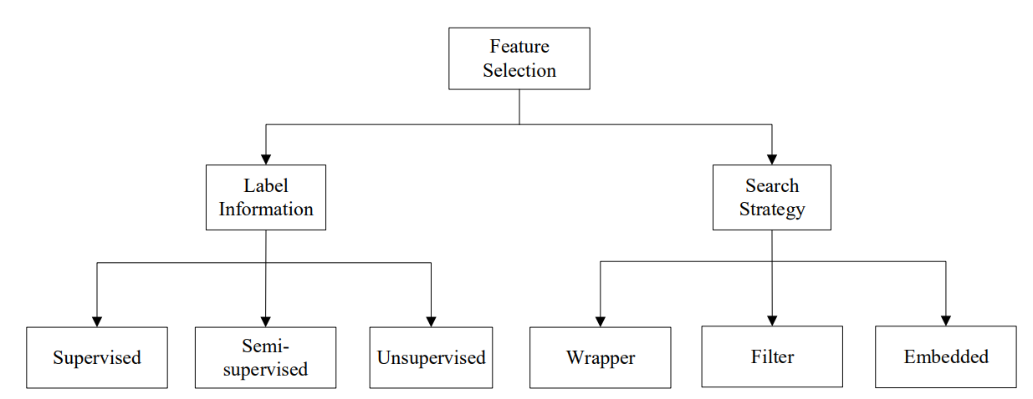
Feature Selection
Based on the different strategies of searching, feature selection can also be classified into three methods, i.e., filter methods, wrapper methods and embedded methods.

Slide 5
02
NSGA-II Algorithm

Slide 6
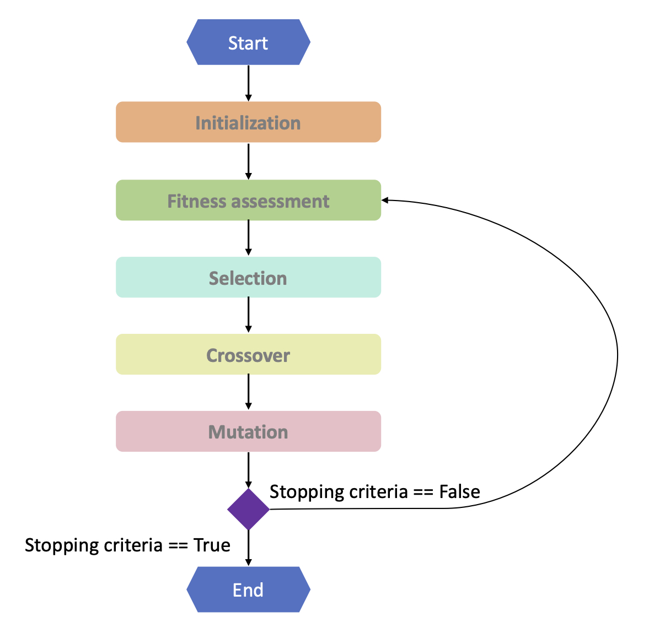
Feature Selection
NSGA-II algorithm is a fast and elitist multi-objective genetic algorithm. The procedure of genetic algorithm can be shown as follows:

Slide 7
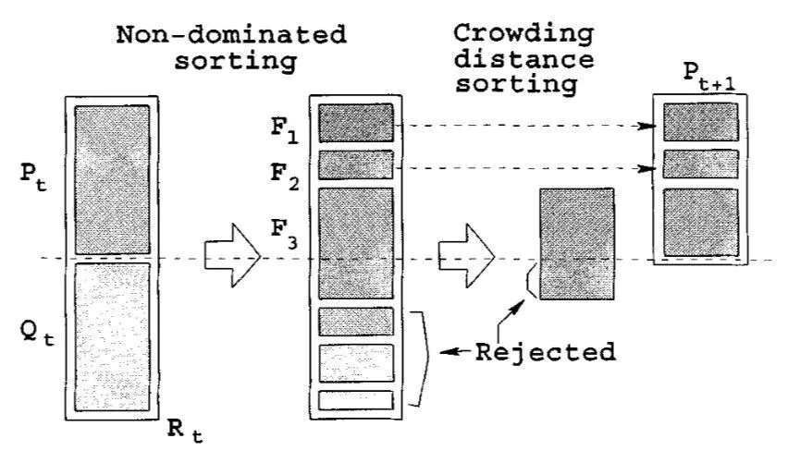
Feature Selection
NSGA-II does the elitism select individuals through fast non-dominated sort and crowding distance assignment:

Slide 8
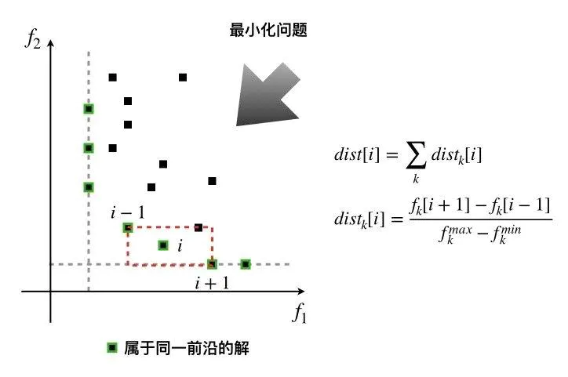
Feature Selection
Fast non-dominated sorting is the process of decomposing the solution set into Pareto fronts of different orders:

Slide 9
Feature Selection
In NSGA II, in order to measure the quality of individual solutions in the same frontier, the authors assign a crowding distance to each solution. The idea behind this is to make the obtained Pareto-optimal solutions as dispersed as possible in the objective space. It is also more likely that the solutions will be uniformly distributed over the Pareto optimal frontier:

Slide 10
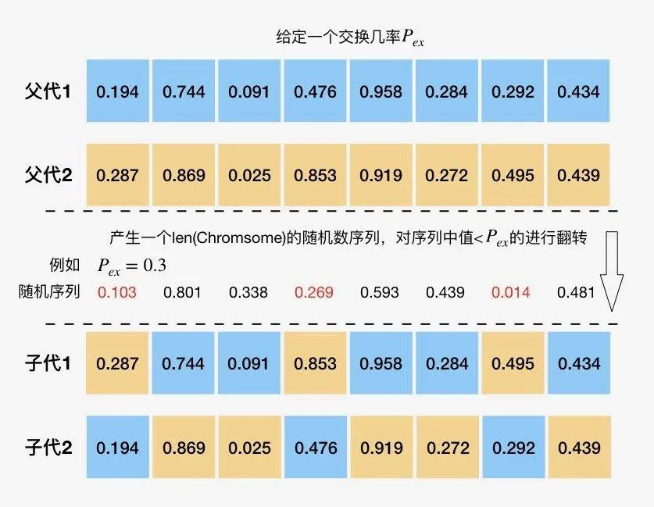
Feature Selection
To apply NSGA-II to feature selection, we used binary individual coding and employed uniform crossover and bit-flipping mutations.
An example for uniform crossover procedure looks like this:

Slide 11
03
Features

Slide 12
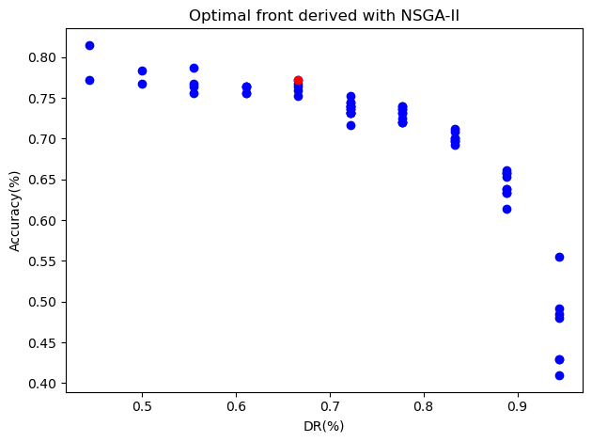
Feature
Visualization:
Blue points indicate the individual generated in the final round and red one specify the chosen one.
Parallel Execution
We employ the "deap" library and implement the parallel execution for the algorithm, which The fully utilized the multicore performance of cpu to significantly increase the speed of operation.
Detailed result compared to the baseline.

Slide 13
04
Conclusion

Slide 14
Conclusion
Thank for your listening.
See repository at Rosenberg37/feature-selection: Class design of "Introduction to Artificial Intelligence" implementing the feature selection with NSGA-II. (github.com)
If you encounter any questions, please contact me at rosenberg371@outlook.com.

